Slide 1
Hospital Database
By: Trevor Appelt, Prabhat Thapa, Vince Lepatan

Slide 2

About The Database
Holds data about a Hospital:
Employee
Patients
Patient Records
Efficiently access and modify

Slide 3
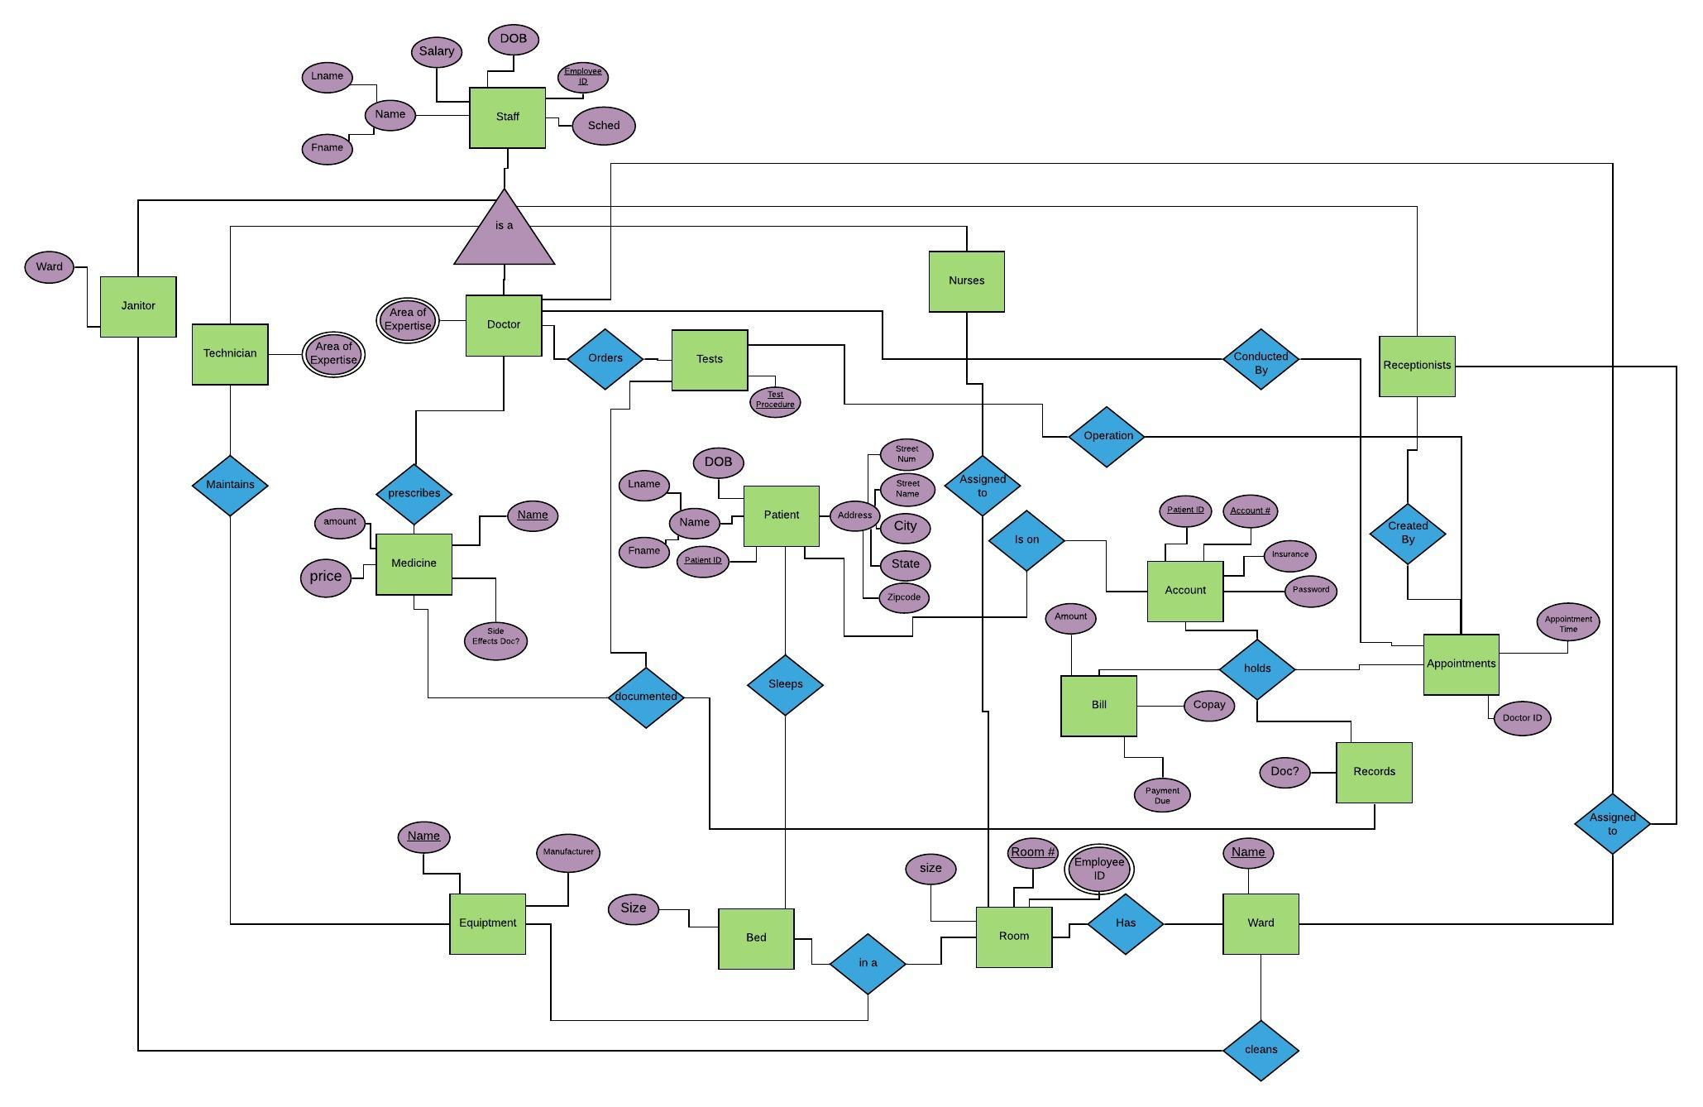
ERD I

Slide 4
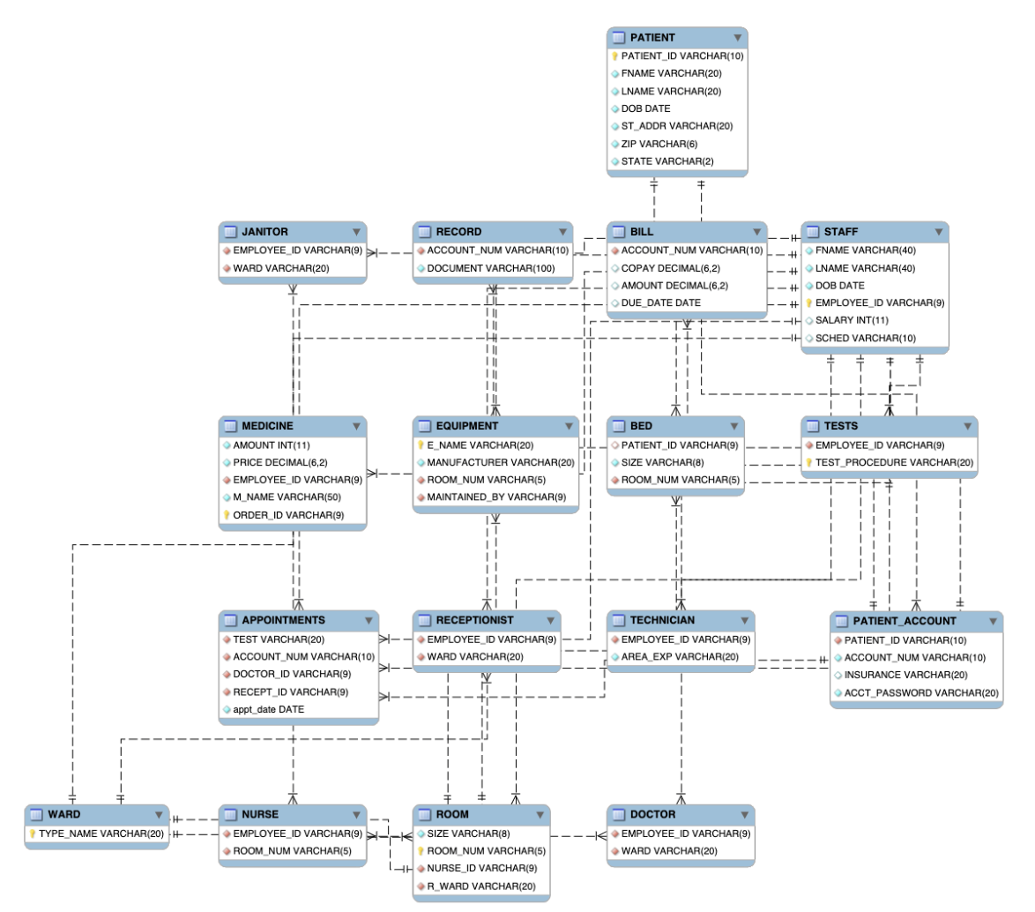
ERD II

Slide 5
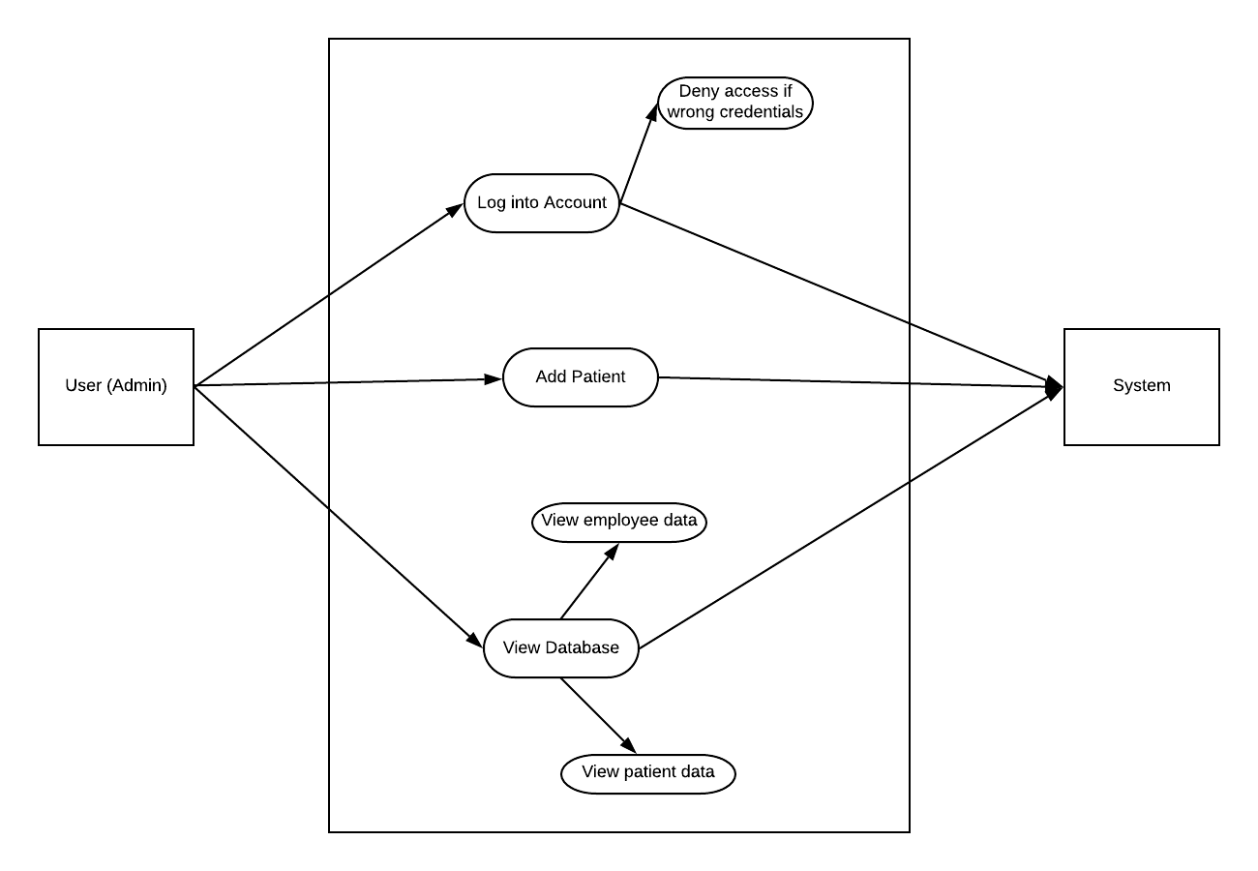
Use Case

Slide 6

Database (MYSQL)
MySQL workbench
Amazon Relational Database Service

Slide 7
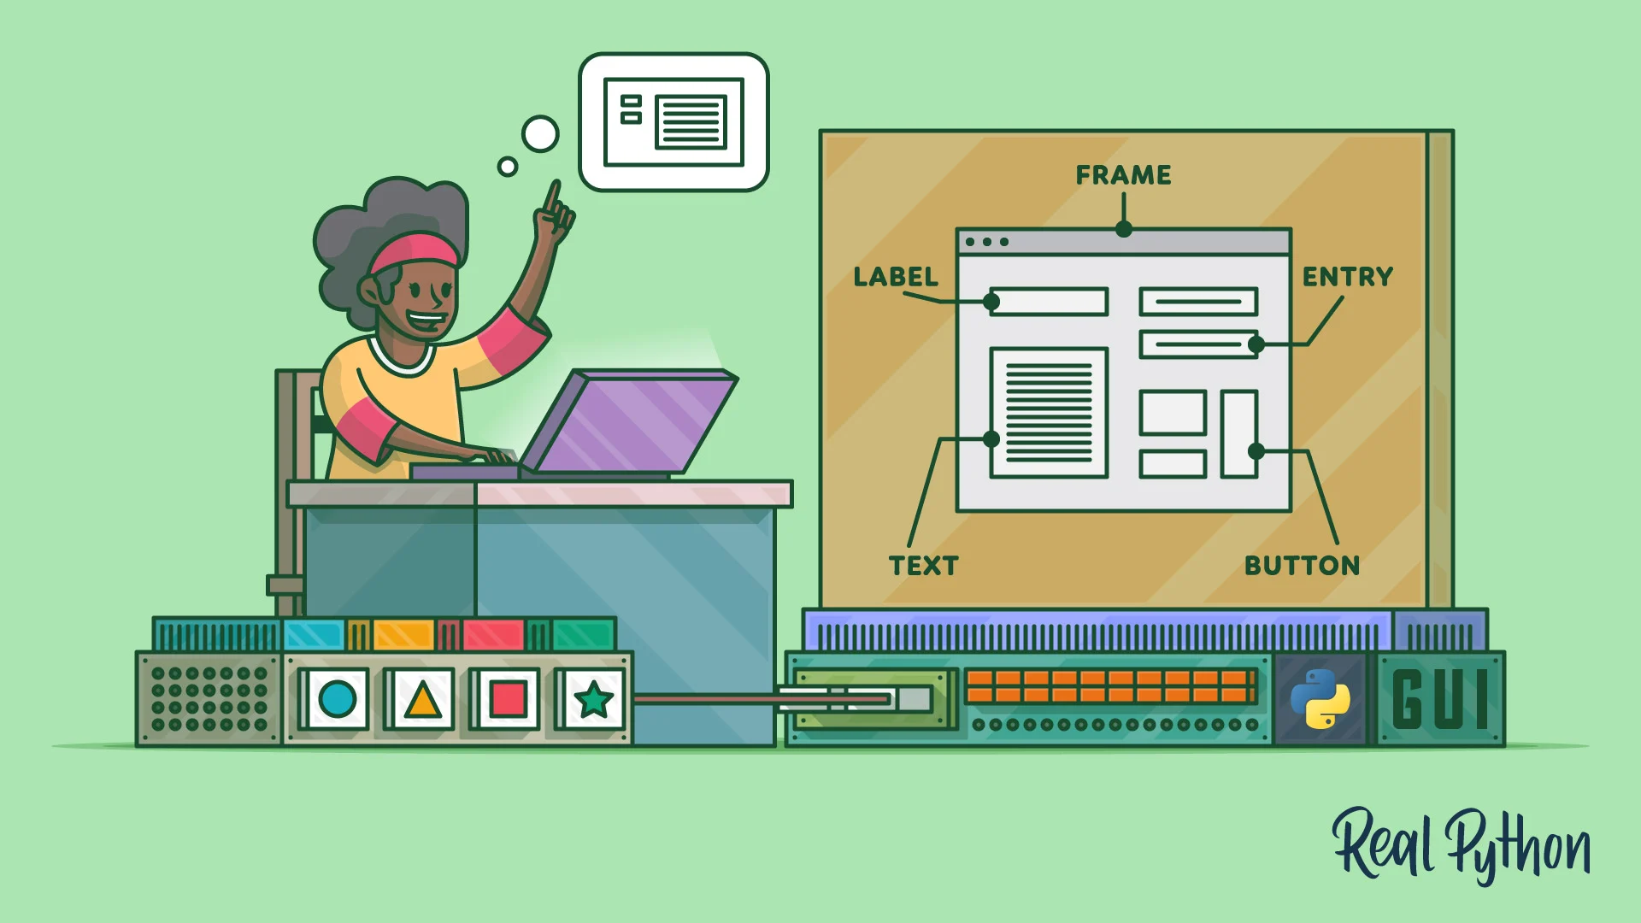
Database Application
Tkinter for GUI
MySQL Connector

Slide 8
Demo

